Slide 1
Semi-supervised Skin Detection by Network with Mutual Guidance
Published in : 2019 IEEE/CVF International Conference on Computer Vision (ICCV)
Author : Yi He , Guanbin Li, Jiayuan Shi, Chuan Wang, Haibin Huang, Jiaming Liu, Risheng Liu, Jue Wang
D0641798 蔡育嘉

Slide 2
Outline
Introduction
Architecture
Result

Slide 3
Introduction
Skin detection is the process of finding skin-colored pixels and regions from images and videos.
Previous skin detection has challenge:
large variation in skin appearance.
depending on its own color proprieties
illumination conditions
With the development of deep learning, the performance of skin detection becomes better.

Slide 4
Introduction
Authors propose to improve skin detection by body detection as a guidance.
The entire network contains a shared encoder but two decoders for skin and body detection separately.

Slide 5
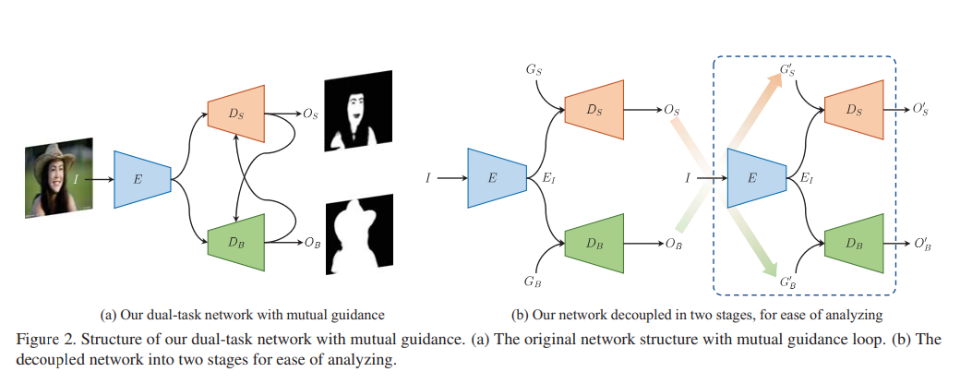
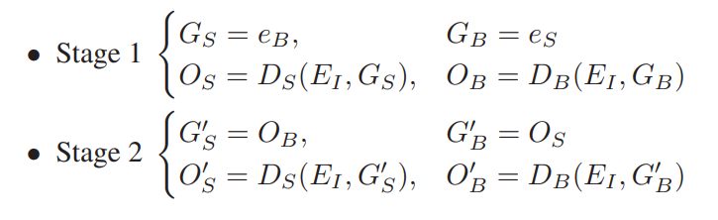
Architecture

Slide 6
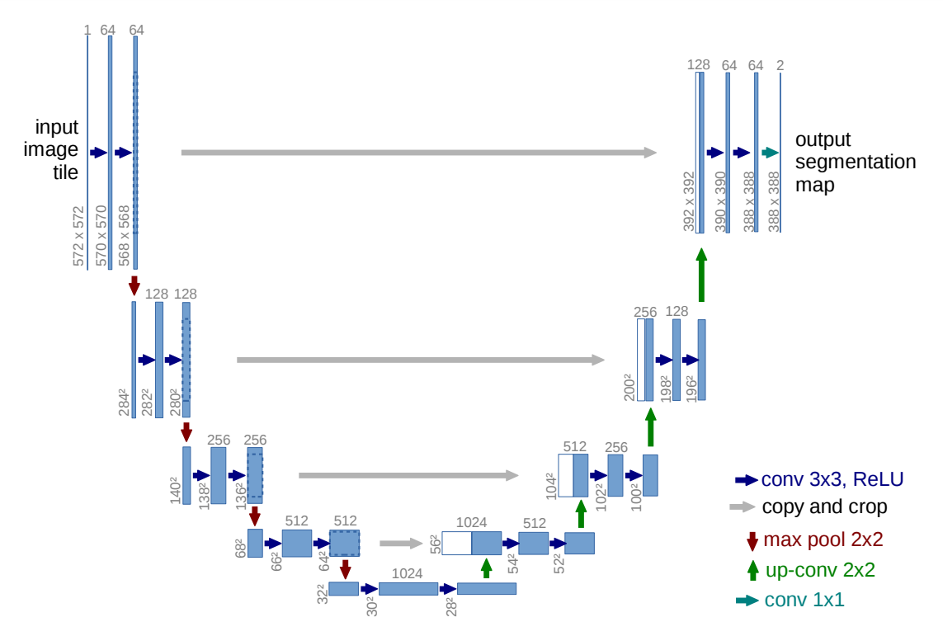
Architecture

Slide 7
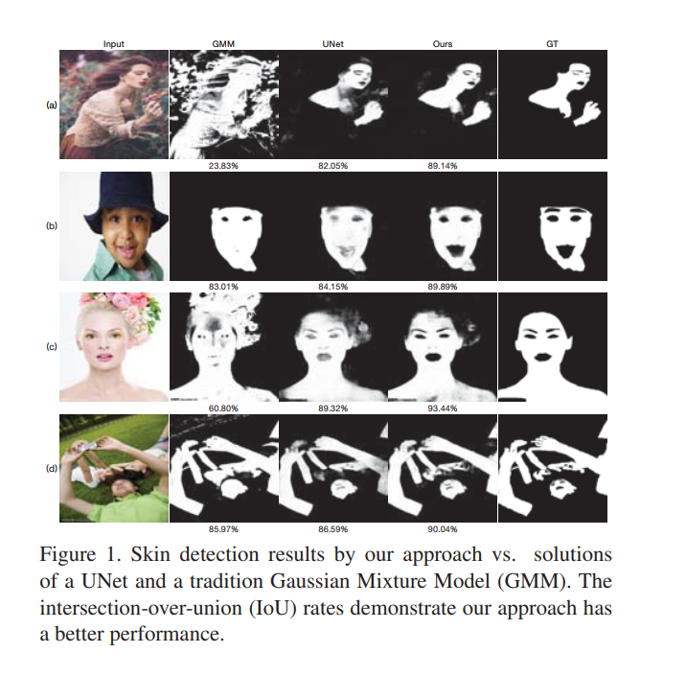
Result

